Slide 1


SCRUM-AGILE METHODOLOGY
The keys to success
over Waterfall

Slide 2
Waterfall approach
The Waterfall method is a development model that works well in the right application. Typically used when the customer has little interaction with the development team. Some of the features of the Waterfall approach includes:
Work is divided into terms and the team works closely on them
Waterfall works well with smaller, less complex projects
The projects goals are clear and defined in beginning stages
Client receives product in final finished product
Requirements
Design
Implementation
Testing
Maintenance

Slide 3
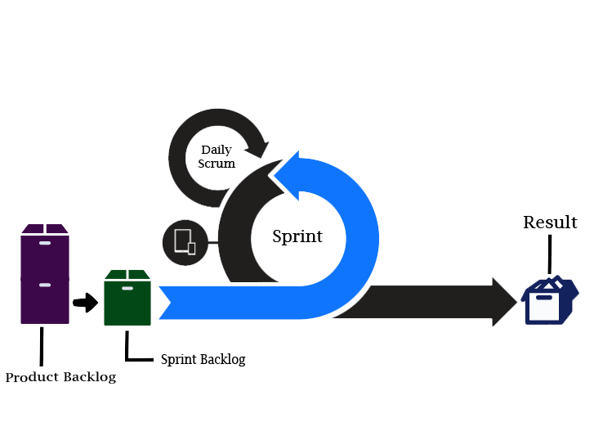
Scrum Approach
Scrum is an Agile methodology, meaning change is not avoided but encouraged. Scrum is more focused on time management, quality of product and complete transparency with customer. Some of the Scrum features include:
Scrum is structured into 3 roles. Product Owner, Scrum Master and Development Team
Scrum works best with complex projects
A project's goal can change at any given time
Includes the customer and stakeholders at each stage
Saves time and money by reviewing short “sprints”

Slide 4
The Three roles of scrum
PRODUCT OWNER
SCRUM MASTER
DEVELOPMENT TEAM
The Product Owner is the connection of the customer to the development team. They have a full understand of what is wanted by the customer, knows what the team can accomplish, and creates a list called a Product Backlog containing everything needed to complete the product.
A Scrum Master knows which scrum practices are best for the task at hand. They ensure that the development team fully understands what is expected by the Product Owner. They schedule the sprint planning, daily scrum meetings, sprint review, and spring retrospectives.
Consisting of a small group of people (no more than 10) of Developers and Testers. Working together to create a product that meets the expectations of the Product Owner. Within a sprint (1 to 4 weeks) developers create code and testers check for user errors, logical errors, and other bugs.

Slide 5
Scrum vs waterfall
Full Transparency, customer and stakeholders included at each stage
Takes in feedback from Product Owner and stakeholders throughout development process
Works well for larger, more difficult and complex projects
Welcomes changes at both early and late stages of development
Work is divided into Sprints, assigned accordingly within team members
No tight deadlines. Customer is aware that every prospect is being developed to their standards
Customer is left in the dark until product is completed
Requirements are taken at beginning of development
Works well with smaller projects
Changes are only available in early requirement phase, no changes in later phases
Divides work into stages and is completed one after the other
Process is bound by tight deadlines

Slide 6

SCRUM AND SNHU TRAVEL
As technology advances, fads coming and going, it is important to stay current. For example, car manufacturing can use a waterfall approach. A set list of features, how to accomplish them, and a set of recalls for anything that might want to be changed once the final product is completed. The customer does not see the new car until the “big unveiling”. Software is very different; it is always changing. Languages, methods, updates, requirements, even the entire direction can change. In the SHNU Travel project, the direction changed at the halfway point. Had the Waterfall approach been in use, this change would not have occurred until the final phase. Having to start from scratch, undo work that has already been completed, all while still trying to achieve a deadline. The change would not even be heard by the developers since the customer is left out of the process until later stages. In the Scrum-Agile method, communication and transparency reign supreme. It is important to give the customer what they want, which is why they are included through every step of the process. Ensuring a product that the stakeholders, customers, and developers can be proud of.

Slide 7
References
Chaudhary, L. (n.d.). Scrum vs Waterfall. Educba.
https://www.educba.com/scrum-vs-waterfall/
Finlay, E. (24 June, 2021). Your introductory guide to the waterfall methodology. MindManager. https://blog.mindmanager.com/waterfall-methodology/
Thakur, M. (n.d.). Scrum Process. Educba.
https://www.educba.com/scrum-process/
The Agile Process 101: Understanding the Benefits of Using Agile Methodology. (15 September, 2020). https://www.nvisia.com/insights/agile-methodology/

